Slide 1


Welcome to E-Book 2
Writing Scientific Research Aticles
Presenter: Jian.Yin
2019/10/22

Slide 2

Contents.
01
Preface
02
The contents of this book
03
Section 1. A framework for success
04
How the book is organized, and why
知行合一、经世致用
Central South University
Notes:
sfddfsdf

Slide 3

01
Preface
自强不息 厚德载物
知行合一、经世致用
Tsinghua University of China
Central South University
Notes:
Robot Operating System 机器人操作系统，简称ROS。
人工智能的浪潮中有一个方面是不可忽视的，就是机器人。 说到我们今天的机器人，最近几年机器人领域非常火爆，出现了一大批这样高质量的产品。
例如，波士顿动力的机器狗，谷歌的无人车，以及国产的大疆无人机等等。
而这当中许多用到了一个共同的运行支撑软件。就是机器人操作系统ROS。

Slide 4

Preface
01
Crowd to this book
Early-career researchers
1. Writing research results
2. Developing skills
知行合一、经世致用
自强不息 厚德载物
Central South University
Tsinghua University of China

Slide 5
Preface
01
Three key areas
Developing strategy : what to publish, and why
Developing story : what makes a compelling research article
Using language : developing techniques
知行合一、经世致用
自强不息 厚德载物
Central South University
Tsinghua University of China

Slide 6

Preface
01
Challenges
Language and culture
authors, journal editors, referees ... ...
知行合一、经世致用
自强不息 厚德载物
Central South University
Tsinghua University of China

Slide 7
02
The contents of this book
自强不息 厚德载物
知行合一、经世致用
Tsinghua University of China
Central South University

Slide 8
The contents of this book
02
Contents
Section 1. A framework for success
Section 2. When and how to write each article section
Section 3. Getting your manuscript published
Section 4. Developing your publication skills further
Section 5. Provided example articles
知行合一、经世致用
自强不息 厚德载物
Central South University
Tsinghua University of China

Slide 9
03
Section 1
A framework for success
自强不息 厚德载物
知行合一、经世致用
Tsinghua University of China
Central South University

Slide 10
A framework for success
03
How the book is organized, and why
Research article structures
Referees’ criteria for evaluating manuscripts
知行合一、经世致用
自强不息 厚德载物
Central South University
Tsinghua University of China

Slide 11
04
How the book is organized, and why
自强不息 厚德载物
知行合一、经世致用
Tsinghua University of China
Central South University

Slide 12
How the book is organized, and why
04
Contents
Getting started with writing
Publishing in international literature
Aims of this book
How the book is structured
知行合一、经世致用
自强不息 厚德载物
Central South University
Tsinghua University of China

Slide 13
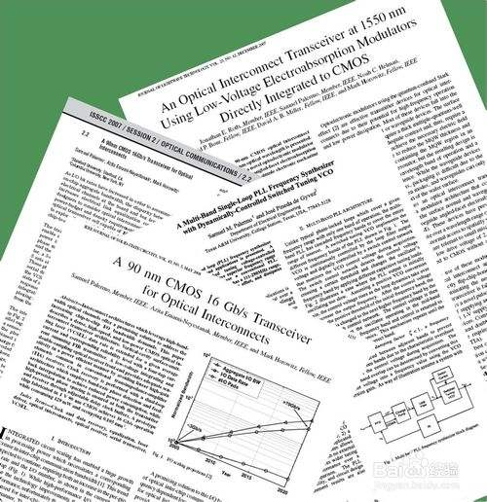
How the book is organized, and why
4.1
The type of document : This genre
paper
manuscript
journal article
researcft article
知行合一、经世致用
自强不息 厚德载物
Central South University
Tsinghua University of China

Slide 14

How the book is organized, and why
4.1
The key concepts
The idea of the audience is a key
Who is your audience ?
1. Scientific peers
2. Journal editor and referees !
知行合一、经世致用
自强不息 厚德载物
Central South University
Tsinghua University of China

Slide 15
How the book is organized, and why
4.1
Expectations in two ways
The article's content and presentation
The English language features
知行合一、经世致用
自强不息 厚德载物
Central South University
Tsinghua University of China

Slide 16
Publishing in the international literature
4.2
Why publish?
Share ideas and results with colleagues
Leave a record of research which can be followed
Receive due recognition
Attract interest
... ...
知行合一、经世致用
自强不息 厚德载物
Central South University
Tsinghua University of China

Slide 17

Publishing in the international literature
4.2
Why publish?
Receive expert feedback
Legitimize your research
知行合一、经世致用
自强不息 厚德载物
Central South University
Tsinghua University of China

Slide 18

Publishing in the international literature
4.2
Why is it difficult to publish?
Not new or of sufficient scientific interest
Experiments do not always work
Scientific journals have specific
requirements
知行合一、经世致用
自强不息 厚德载物
Central South University
Tsinghua University of China

Slide 19

Publishing in the international literature
4.2
Why is it difficult to publish?
Potential criticism
1. Advancing is adversarial
2. New results and ideas are debated
知行合一、经世致用
自强不息 厚德载物
Central South University
Tsinghua University of China

Slide 20

Publishing in the international literature
4.2
What require?
Understand the ‘‘cutting edge’’
知行合一、经世致用
自强不息 厚德载物
Central South University
Tsinghua University of China

Slide 21

Publishing in the international literature
4.2
Understand the ‘‘cutting edge’’
Getting access to the journals
Subscribing e-mail alert schemes
Developing skills for searching
Active involvement conferences
知行合一、经世致用
自强不息 厚德载物
Central South University
Tsinghua University of China

Slide 22
Publishing in the international literature
4.2
Know to select target journal
Does publish work you have done?
Cite their work
Does journal referee the papers?
Enhancing the credibility
知行合一、经世致用
自强不息 厚德载物
Central South University
Tsinghua University of China

Slide 23
Publishing in the international literature
4.2
Know to select target journal
Does journal publish reasonably quickly?
Are there page charges?
知行合一、经世致用
自强不息 厚德载物
Central South University
Tsinghua University of China

Slide 24

Publishing in the international literature
4.2
Get the most out of publishing
Publishing quickly
Higher citation index
知行合一、经世致用
自强不息 厚德载物
Central South University
Tsinghua University of China

Slide 25
Aims of this book
4.3
Aims of this book
Understanding structure and underlying logic
Turning a set of results into a paper
Analysing the structure and language features
Stages in the process of submitting
... ...
知行合一、经世致用
自强不息 厚德载物
Central South University
Tsinghua University of China

Slide 26
Book structure
4.4
Two principles
People learn best by doing
Developing your skills
知行合一、经世致用
自强不息 厚德载物
Central South University
Tsinghua University of China

Slide 27
Book structure
4.4
Different categories of articles
Provided Example Article(s) (PEAs)
Own Article (OA)
Selected Article (SA)
知行合一、经世致用
自强不息 厚德载物
Central South University
Tsinghua University of China

Slide 28

Thanks for all

